Slide 1
Advanced Github and Git
How to use these tools to Skyrocket Your Software Development Productivity
Fernando Garzon, August 2024
ofgarzon@ucsd.edu, github.com/ofgarzon2662, linkedin.com/in/fernando-garzon-49aa8317b/

Slide 2

Who’s Fernando Garzon
Computational & Data Scientist Research Specialist at SDSC
Work on User Support for TSCC.
Also work in Software Dev (SWD) projects within SDSC
Currently finishing my 2nd master in SW Engineering.
Passionate about SWD, DevOps, Automation, Cloud Architecture, IaC and more.
Automation Enthusiast.
Notes:
* I'm a physicist and a master in physics

Slide 3
Outline
Intro: From Legacy Mess to Deployment Success
Let's Prod the Heck Out of This!
The Quality-Speed Trade Off Myth
Let’s Talk GitHub, Not Jargon!
Be Agile

Slide 4
Outline
Recetario App
Lights, Camera, GH Actions!
Automating your way to Prod
Final Remarks

Slide 5

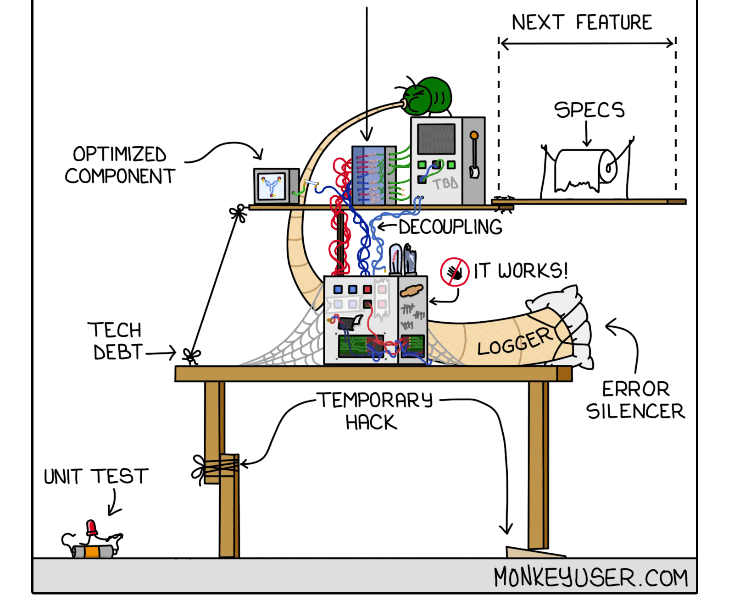
From Legacy Mess to Deployment Success
Notes:
* Many of you come from Academia
* Some folks have a lot of knowledge about Quantum chemestry ... but deploy horrible software
* Old stuff written in Fortran or even Asemble or something very old and unmaintained.
* Code so that you won't be remembered with hate, but in a lovely manner.

Slide 6

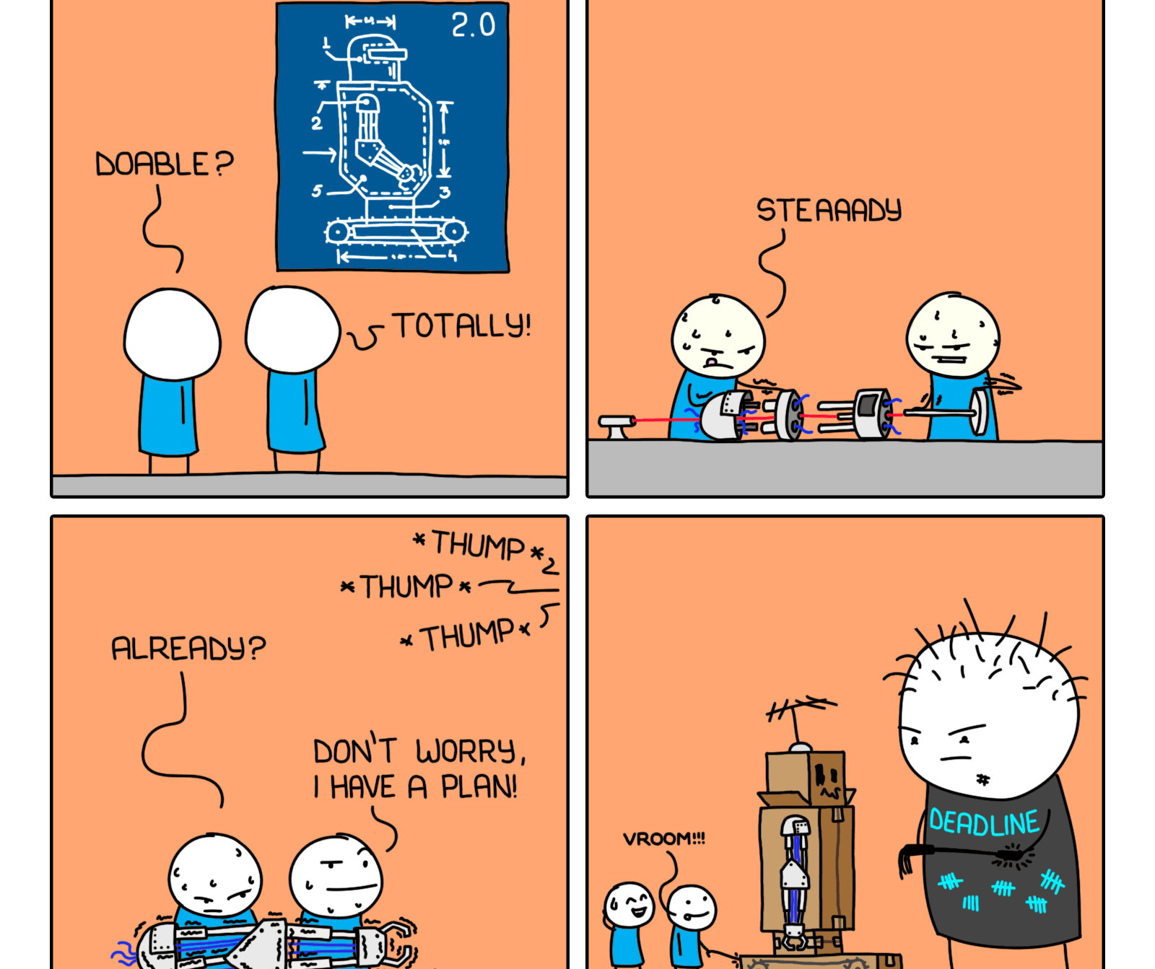
Let’s Prod the Heck Out of This
Notes:
* You get to define what a prod state is.
* There are 2 kinds of data engineers: The ones who know how to take their code into prod, and the bad ones.

Slide 7
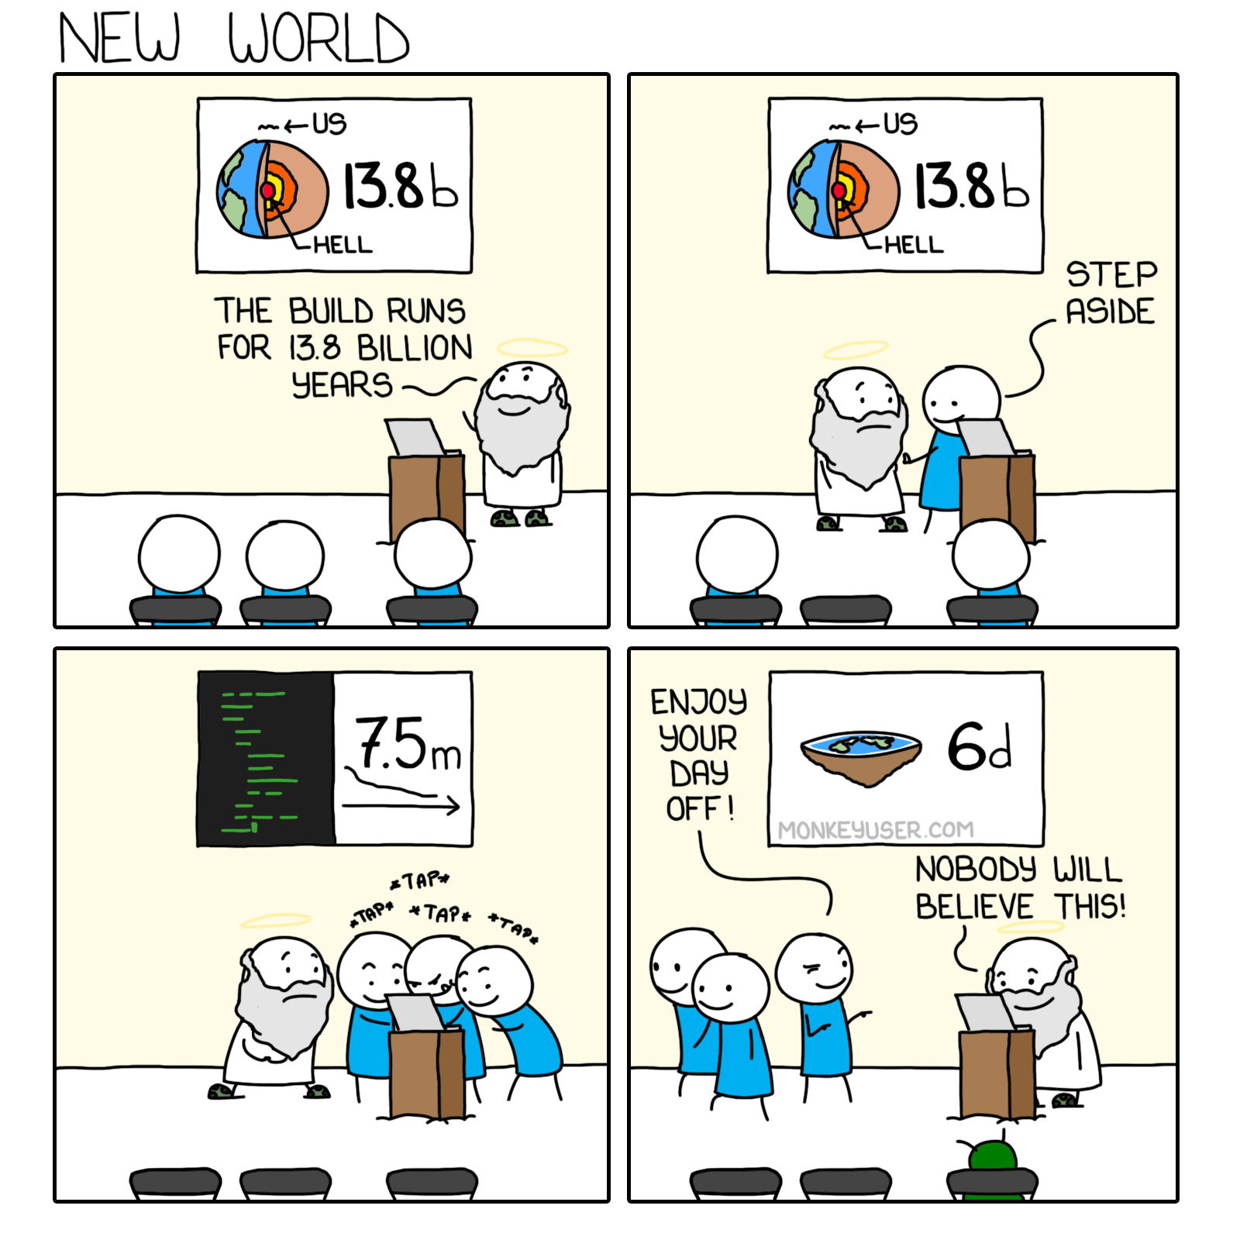

The Quality-Speed Trade Off Myth
Notes:
* There are fields of knowledger where you can't be fats. You need to be slow, and rigurous in order to be high quality.
* SWD is really not one of those fields. You can be fast and very high quality at the same time.
* In fact, If you can't, you die in the industry.
* Academics sometimes like to keep it a bit slow and ambituous, but when it comes to coding, there isn't need for that. Refer the cartoon.

Slide 8
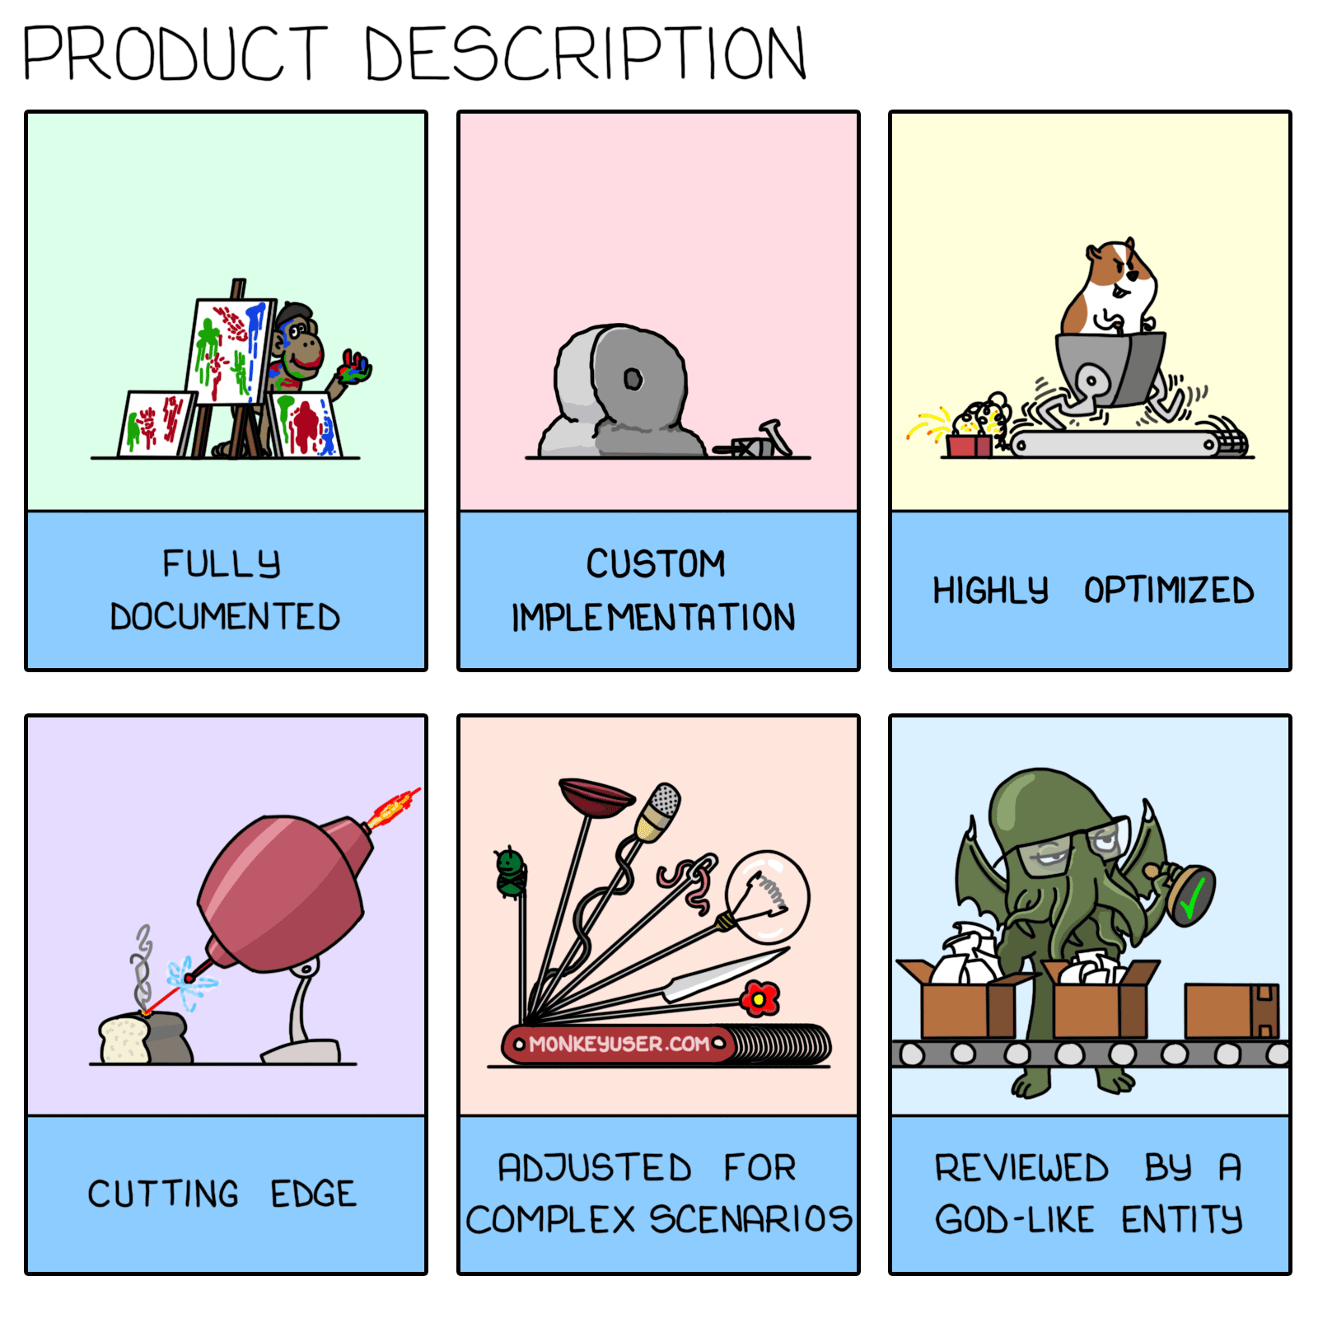
The Quality-Speed Trade Off Myth
Desire without knowledge is not good—how much more will hasty feet miss the way!
Proverbs 19:2 (NIV)
Notes:
* What I do not Mean by speed. Then click for the Proverb.
* Tell the story of folks planningt he coding of a cool app that creates you an schedule, based on AI.
* An AH codes away and screws it all up.
* That ain't fast. That is the opposite of fast.
There are start ups that are succesful because what sells is the bussines idea, not the code or the unit tests. Eventually, there needs to be some project management to the enterprise.

Slide 9

The Quality-Speed Trade Off Myth
Amazon: 136k Deps. a day.
Google: O(10k) Deps a day.
Netflix: 500 Deps. a day.
Etsy: 50 Deps. a day.
Meta: 1 Dep. a day.
Notes:
* Moral: You can be the friking Jack Rabbit and still win the race. You just need to be disciplined, and passionate about the product.

Slide 10

Let’s Talk GH, Not Jargon

Slide 11
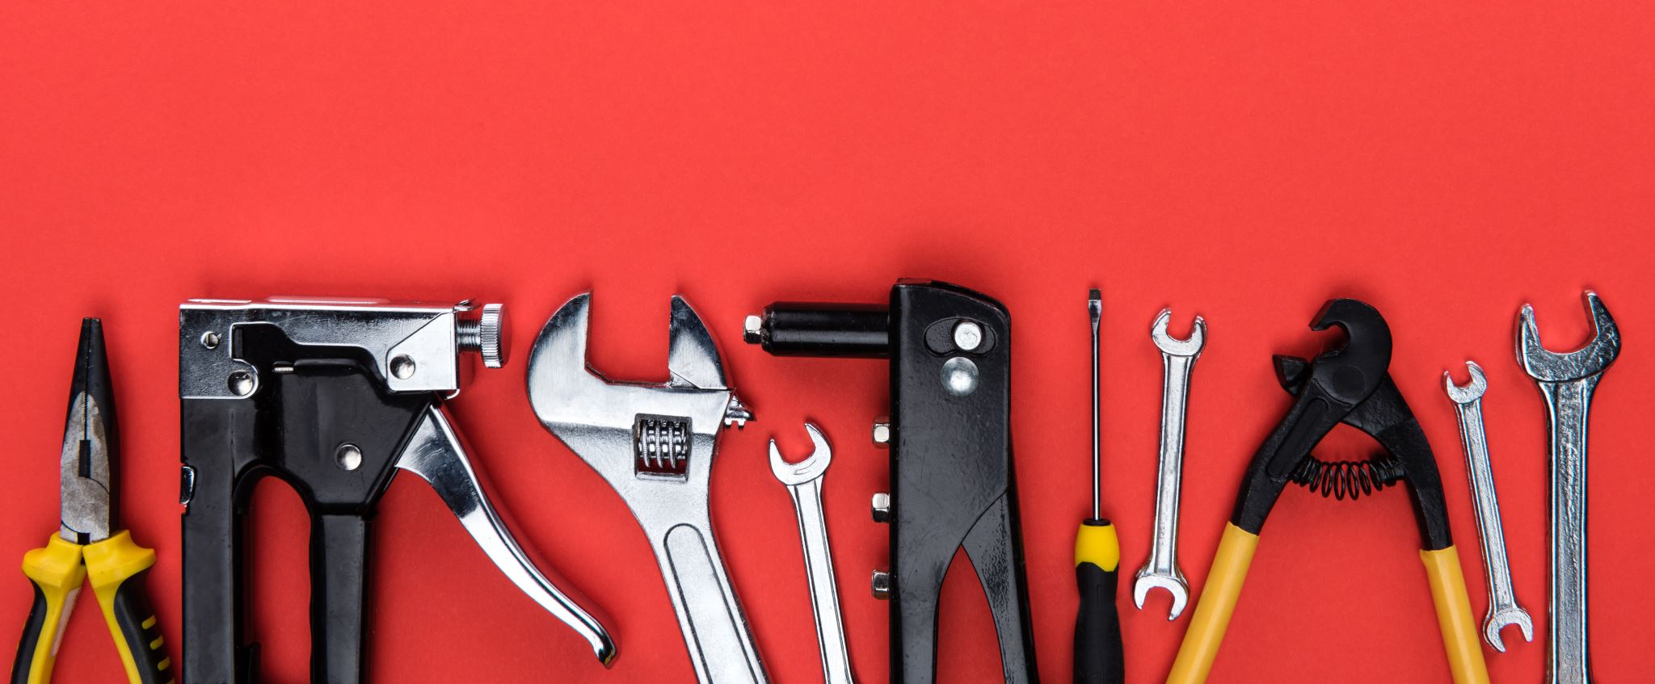
Be Agile: Don’t Hit the Nail With the Hammer Handle
Notes:
* Agile is a Product/Project Management strategy, or a combination of PM strategies.
* Created specifically for SWD, but also used in marketing, design, and creative fast-paced industries.

Slide 12
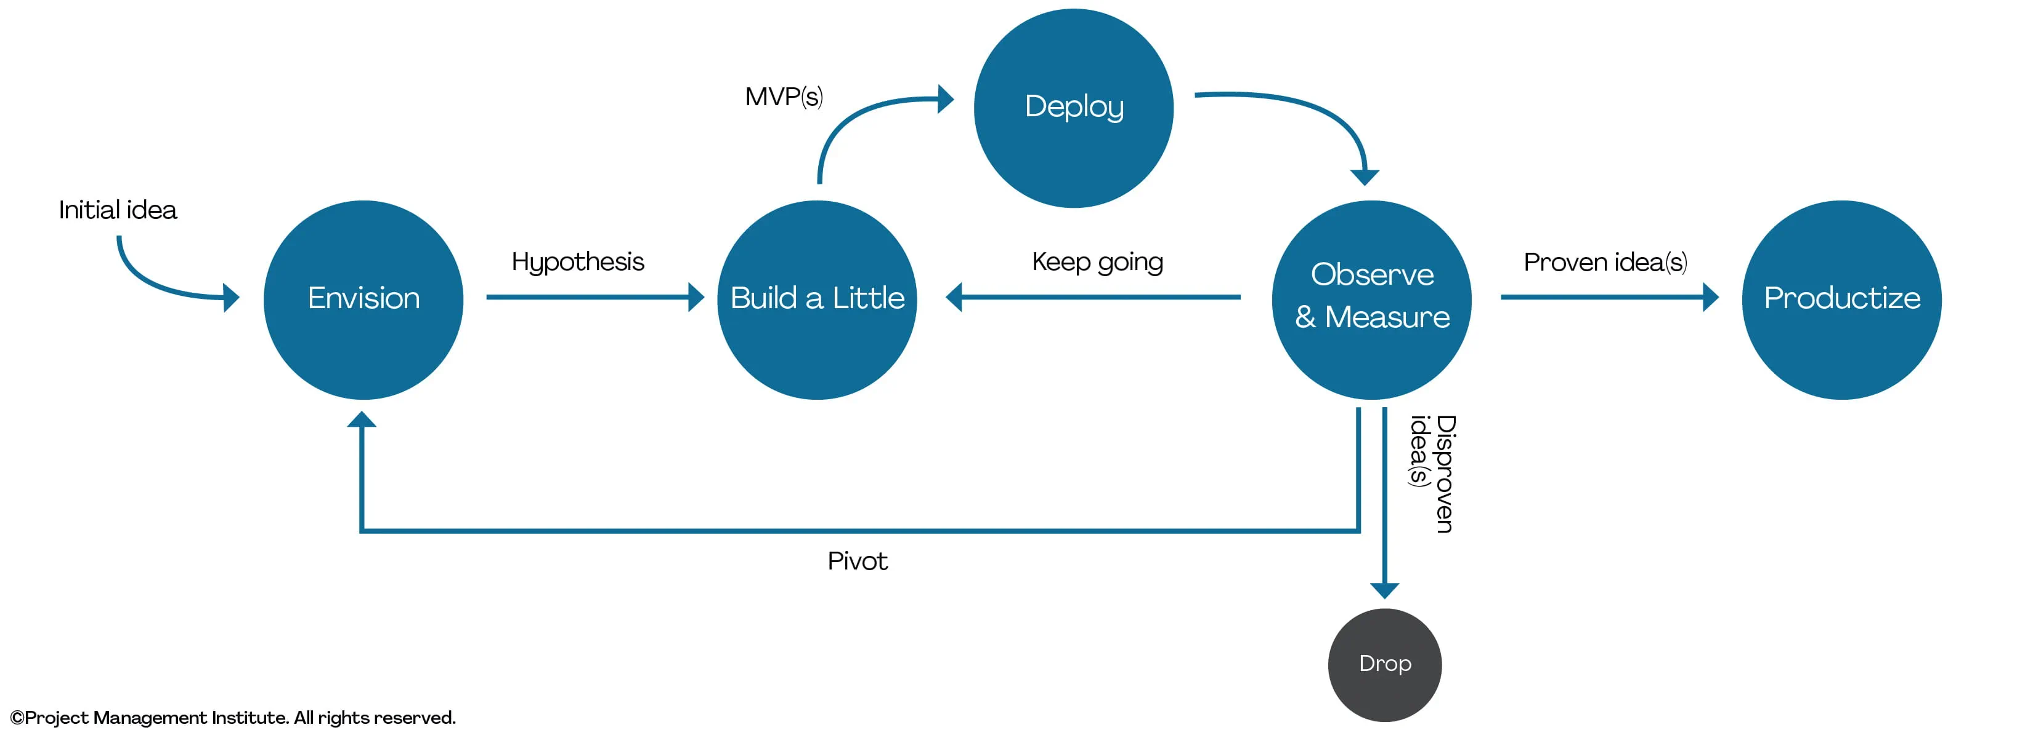
Be Agile: Don’t Hit the Nail With the Hammer Handle
DAD Exploratory cycle
Image reference: https://www.pmi.org/disciplined-agile/lifecycle/exploratory-lifecycle
Notes:
* Production doesn't always mean Final Users can use the Product. It only means that the code can live peacefully in a Productive environment prior a release.

Slide 13
Be Agile: Don’t Hit the Nail With the Hammer Handle
Notes:
* Production doesn't always mean Final Users can use the Product. It only means that the code can live peacefully in a Productive environment prior a release.

Slide 14
Be Agile: Don’t Hit the Nail With the Hammer Handle
DAD Exploratory cycle
Image reference: https://www.pmi.org/disciplined-agile/lifecycle/exploratory-lifecycle
Notes:
* Production doesn't always mean Final Users can use the Product. It only means that the code can live peacefully in a Productive environment prior a release.

Slide 15
Recetario App
Notes:
* Production doesn't always mean Final Users can use the Product. It only means that the code can live peacefully in a Productive environment prior a release.

Slide 16
Final Remarks
Keep learning how to maximize your productivity with GH, Git, and AGILE.
Avoid leaving a bad legacy.
Keep it fast, keep it classy.
Don’t write any of code until you know the purpose. Disregarding that is the opposite of fast and classy in SWD.
Focus on fundamentals, not the Jargon.
Automate away. Cherish your time.

Slide 17
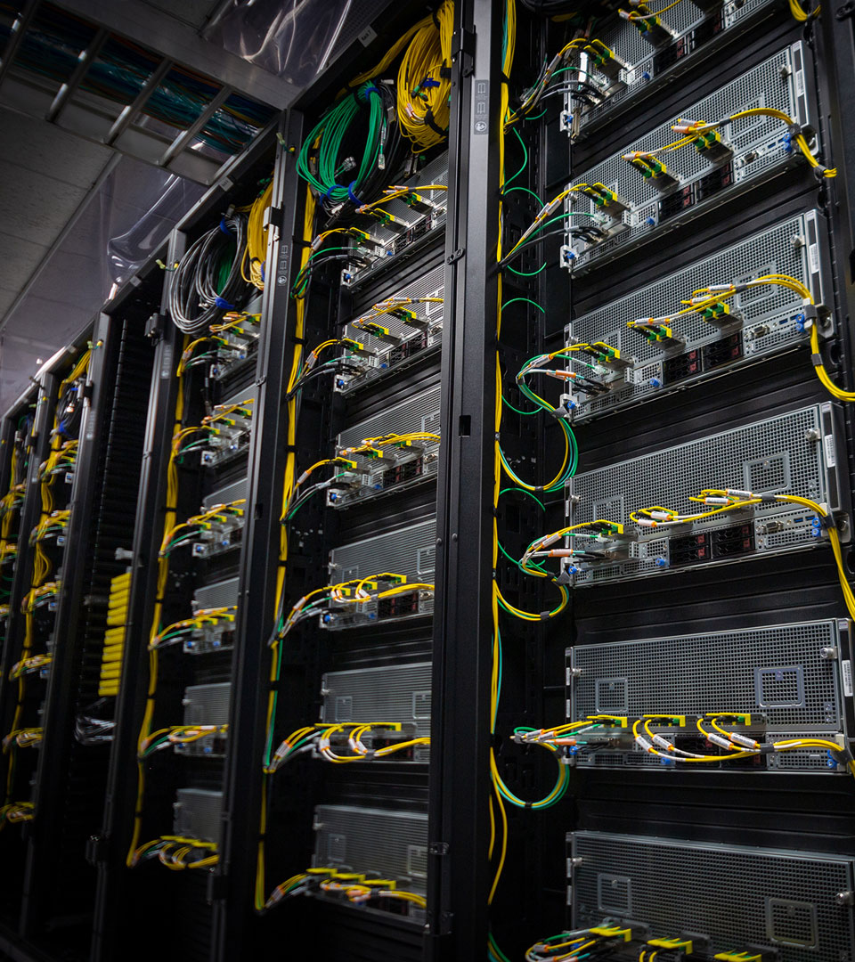
Questions

Slide 19


The Quality-Speed Trade Off Myth

